Slide 1
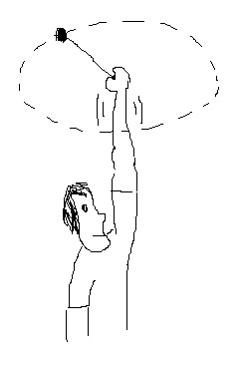
Circular Motion – A Hands-on Exercise!

Slide 2
Warning: Discussion Ahead
This lesson has a fair bit of discussion in it
Anyone who has done a lab report will have experienced how annoying the discussion section is if the questions are vague and you don’t know what the grader wants
To avoid this situation, station mentors for every group for the entire duration of the lesson that doesn’t require disseminating materials to help with the discussion.

Slide 3
Introduction
F = ma
When an object moves in a circle there is a force pushing the object outwards and another force pulling it inwards.
These forces are balanced as well, which is why there is no motion radially outwards or inwards.
Example in lesson plan: Roller coasters

Slide 4
Module 1: Demonstrate Balanced Forces
Tug of War
When the force applied on the two ends of the rope is equal, the knot at the center of the rope won’t move
But let’s add a complication …

Slide 5
What if Forces are Balanced but --?
Discussion activity: If you were leaning against a wall made from styrofoam/sponge, would the wall be able to support your weight or would it break?
Bearing this result in mind, disseminate the CFGs.

Slide 6
Module 2: CFGs part 1
If you split the class into groups of 4, let 2 of the group members perform this module and the other 2 will perform module 3. However they will all participate in the discussion ☺
Place the cup with a Marble-in-jello inside the cup which has a string tied to it (the basket cup)

Slide 7
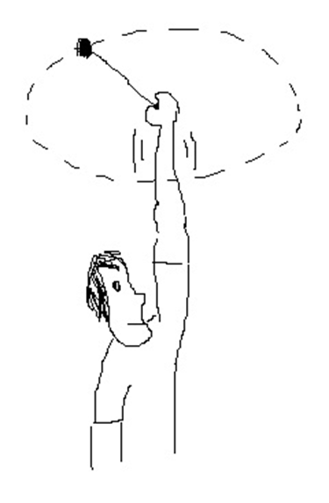
Twirl that cup!
Do it 10-15 times.
Be sure to remind them to do it slowly and to keep a good distance from any other students!
Observe the change in the position of the marble. Ask the students to try and explain it

Slide 8
After Module 2
The marble moves outwards when you rotate the CFG. This is sort of like the wall example.
The marble, when rotated, exerts a center fleeing force which is balanced by the jello. However, the jello is not strong enough structurally to oppose the marble which wants to move outwards, so it “breaks”.

Slide 9
Module 3: CFGs again
Performed by the other 2 group members of each group
Same as before but this time we give CFGs with a modification.
Mod 1: CFG has a large marble instead of a small marble. Everything else same.
Mod 2: “Basket cup” has a longer/shorter string than before. Everything else same.

Slide 10
Hypothesis forming!
Have the kids discuss in groups what they think will happen to the position of the marble in their new CFG setup.
Write down their hypotheses at the front of the class in a table like this:
Group 1 | Longer string | (expected outcome 1)
Group 2 | Bigger Marble | (expected outcome 2)
… | … | …

Slide 11
Check whether the hypothesis fits the results
Twirl the CFG the same number of times as before and (if possible) try and keep the velocity the same (AKA not very fast ☺)
Compare the position of the marble in the two CFGs (the normal one and the modified one)
Does the hypothesis fit the results?

Slide 12
… If they haven’t fallen asleep already
The centripetal force is proportional to the mass of the object performing the circular motion (F large marble > F small marble) if string length, speed of rotation is held constant
The centripetal force is inversely proportional to the string length (F long string < F short string) if speed of rotation, mass of marble is held constant

Slide 13
Module 4: EGG DETECTIVES
If any of the other modules can’t be performed, use this one!
A little bit of fun at the end of the lesson
Although it isn’t exactly related to the centipetal force demo, it isn’t too big a stretch.

Slide 14
Procedure
Give 1 boiled/fresh egg for every 2 kids. Have them figure out if it is boiled or fresh without cracking it open/trying to shake it to hear a swishing sound.
Instead, twirl the egg along its oblong axis and observe if it can rotate without wobbling or not.

Slide 15
Hints
“think about the egg white and egg yellow in the raw egg, which one is softer, which one is harder?”
“in a boiled egg which one is harder, the egg white or yellow?”
“think about the jello and marble in the cup. Do you see something they have in common?”
“if I spin something with 1 hard and dense and 1 soft component, will the hard component move or will it stay in the same position?”

Slide 16
Answer
In a fresh egg, much like the marble in the CFG, the yolk will move outwards from the center of rotation when the egg is spun. This makes the rotation not balanced since the center of mass of the egg is changing. The egg will wobble and stop spinning. The boiled egg, however, has a fixed center of mass so once it starts spinning it won’t wobble and will spin longer.

